Slide 1
Pipe Data Collection and Export Application Team Hacksand Ridge
12/1/2017

Slide 2
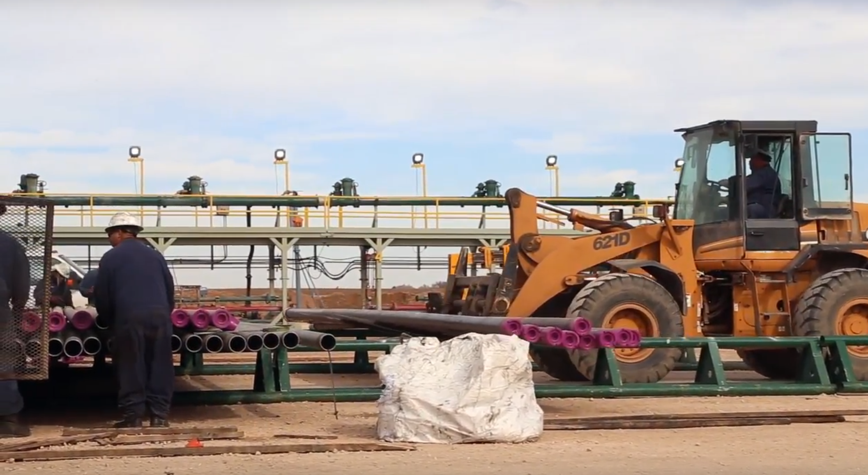
Safety always

Slide 3
Safety always

Slide 4
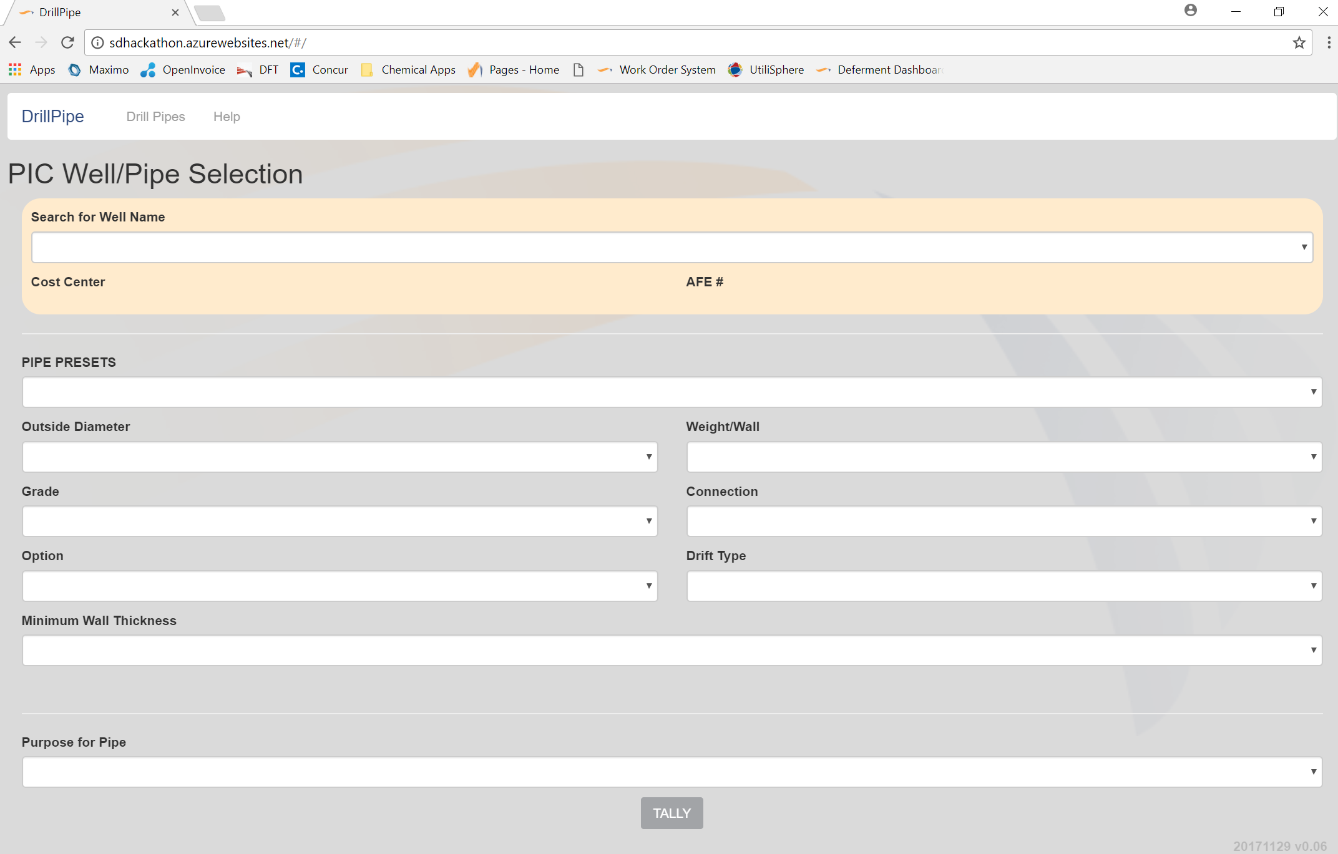
Web – based application
http://sdhackathon.azurewebsites.net/

Slide 5
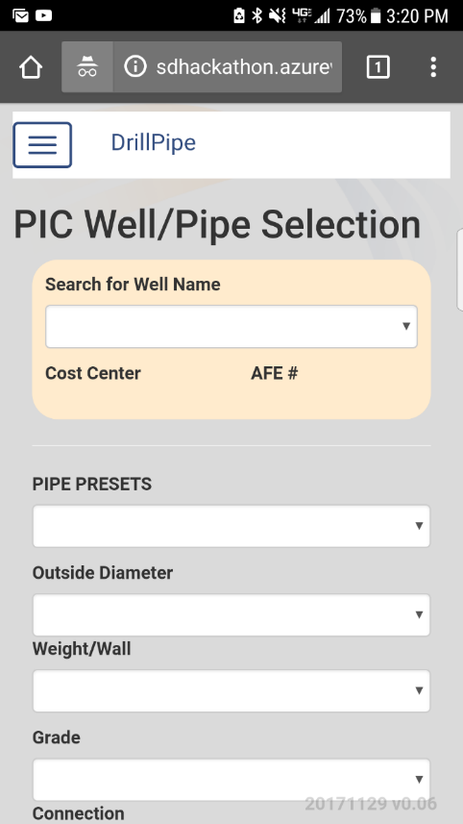
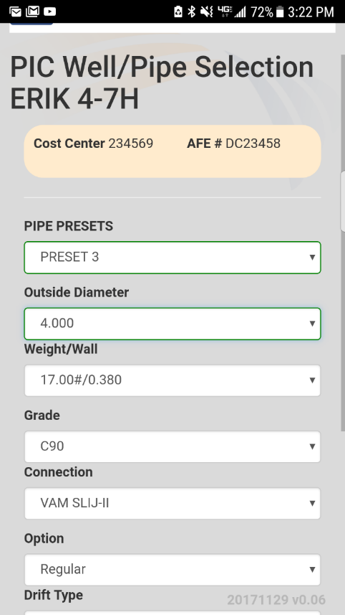
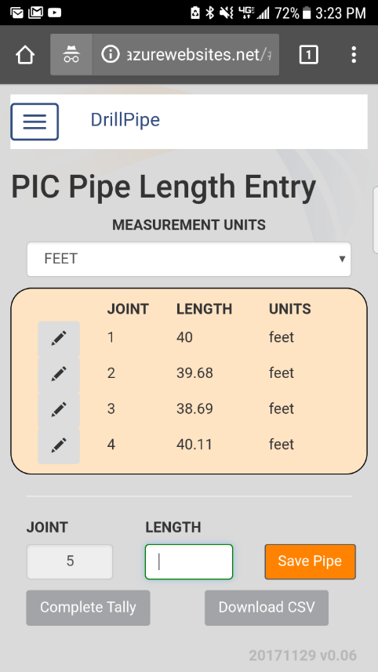
Mobile Friendly

Slide 6
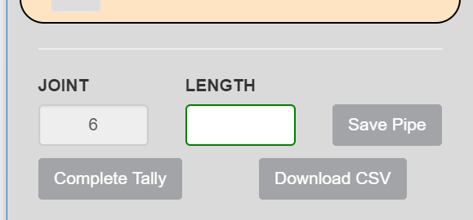
Export Data to CSV

Slide 7
Export Data to CSV

Slide 8
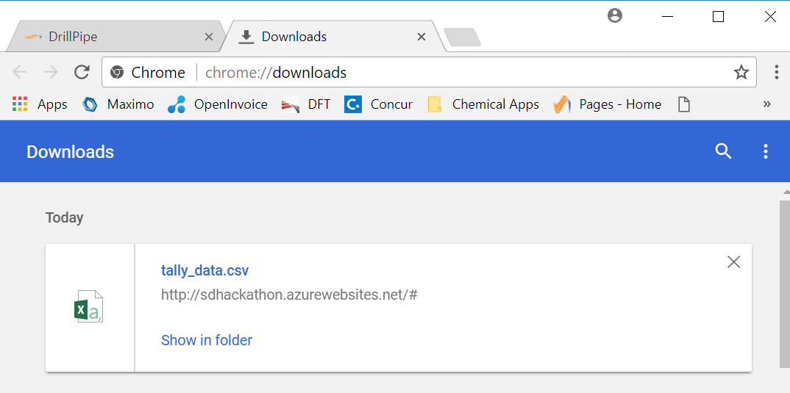
Export Data to CSV

Slide 9


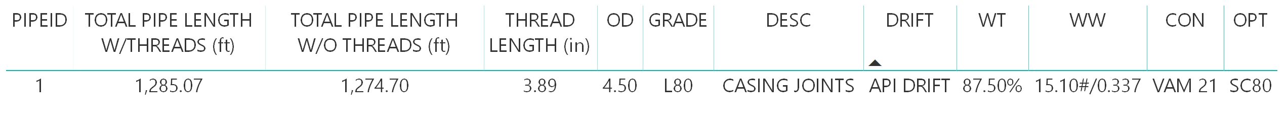
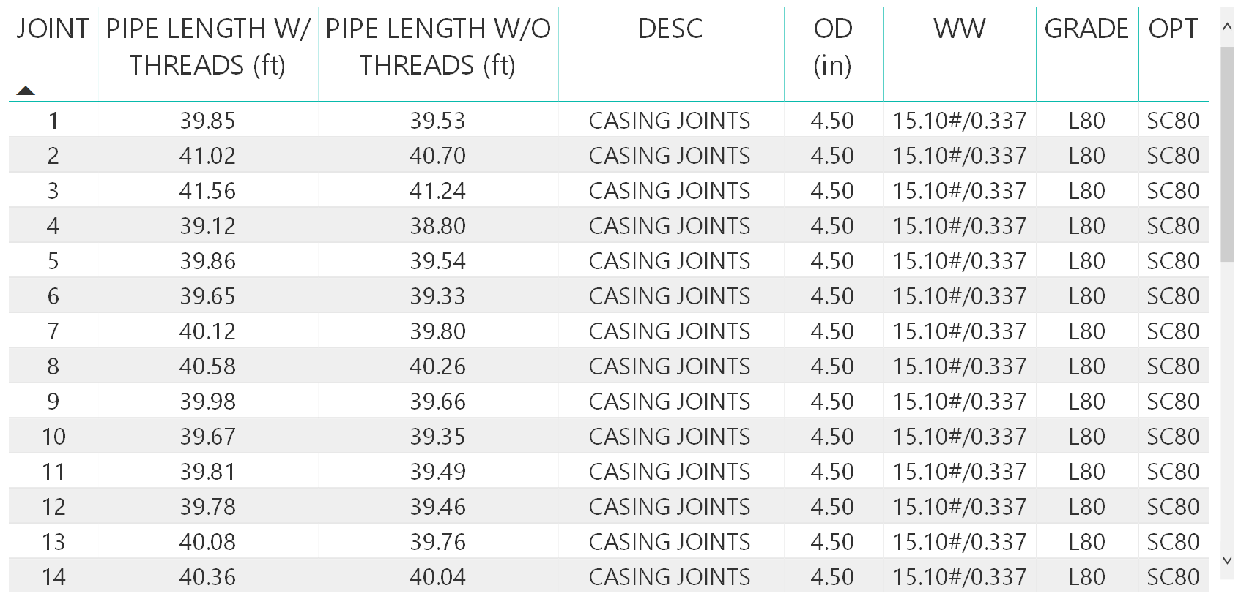
Various Power BI Reports
Inventory Summaries:
Individual Pipe Details:

Slide 10
QUESTIONS?
^{SANDRIDGE ENERGY}
123 Robert S. Kerr Avenue, Oklahoma City, OK 73102
^{www.SandRidgeEnergy.com}

Slide 11
